Slide 1
JCFGM Board of Trustees Meeting
November 28, 2022

Slide 2
Mission Statement
The Foundation is organized to promote philanthropy and to further the charitable needs of the Jewish community, other charitable institutions, and community organizations.

Slide 3
Minutes
Approval of Minutes June 23, 2022
Approval of Minutes September 19, 2022

Slide 4
Agenda
Call to order
Approval of Minutes
President’s Report
Treasurer’s Report
Proposed Strategic Work Plan
Executive Director’s Report
Committee Reports
Updates
Old Business
New Business
Good and Welfare
Adjournment

Slide 5
Assets and Fund Activity
FY23 as of Nov 21, 2022
Number of Funds
31 Custodial Funds
24 Permanently Restricted Funds
11 Temporarily Restricted Funds
81 Donor Advised Funds
5 Foundation Funds
152 Funds Total
New Funds
7 new funds (6 DAFs, 1 Custodial)
Closing Funds
3 funds (2 DAF, 1 Perm. Restricted) will be closing prior to year-end
Contribution Activity – 30 contributions totaling $183,147
Grant Activity – 182 grants totaling $597,343
Assets – LINDA TO COMPLETE

Slide 6
Technology update
FidTech Contract signed
Renaissance notified of termination
Go Live Date May 1, 2023

Slide 7
Treasurer’s Report

Slide 8
Proposed Strategic Planning Work Plan

Slide 9
Executive Director’s Report
Federation Grant: JCFGM received $2,500 from the Jewish Federation PMB Allocations committee to plan programs to build a Culture of Philanthropy through Life & Legacy. The workshop titled Choose Abundance featuring Laurie Herrick will take place on December 5th and January 30th. JCFGM Trustees are invited to join.
Harold Grinspoon Foundation grant of $40,120 per year for two years – this is to fund the Life & Legacy Plus initiative. Amy is the lead staff. There are meetings every quarter with the teams. We have worked hard to clarify language to ensure that gifts are clearly indicated for the Life & Legacy funds.
Fund holders have been contacted and asked to complete all transactions no later than December 15^{th,}

Slide 10
Committee reports
Investment committee
October returns were positive 3.86%, which exceeded our 70/30 benchmark thanks to outperformance from the bond component of the portfolio
Year-to-date returns of -19.31% (not shown on Vanguard report), lagging the benchmark.
Since Inception with Vanguard (July 1, 2020) of 1.39%, very slightly ahead our benchmark (which changed over time from 60/40 to 65/35 then 70/30). That is also very slightly ahead of my own calculation of the 60/40 benchmark.
You may remember that last month the committee voted to maintain our Inflation Protected bonds within the portfolio (that position is 7.5% of the portfolio and has been a great source of outperformance). However, early in November “new news” on the inflation front prompted a revote, and the committee voted to exit that position gradually over the next 7 quarters.

Slide 11
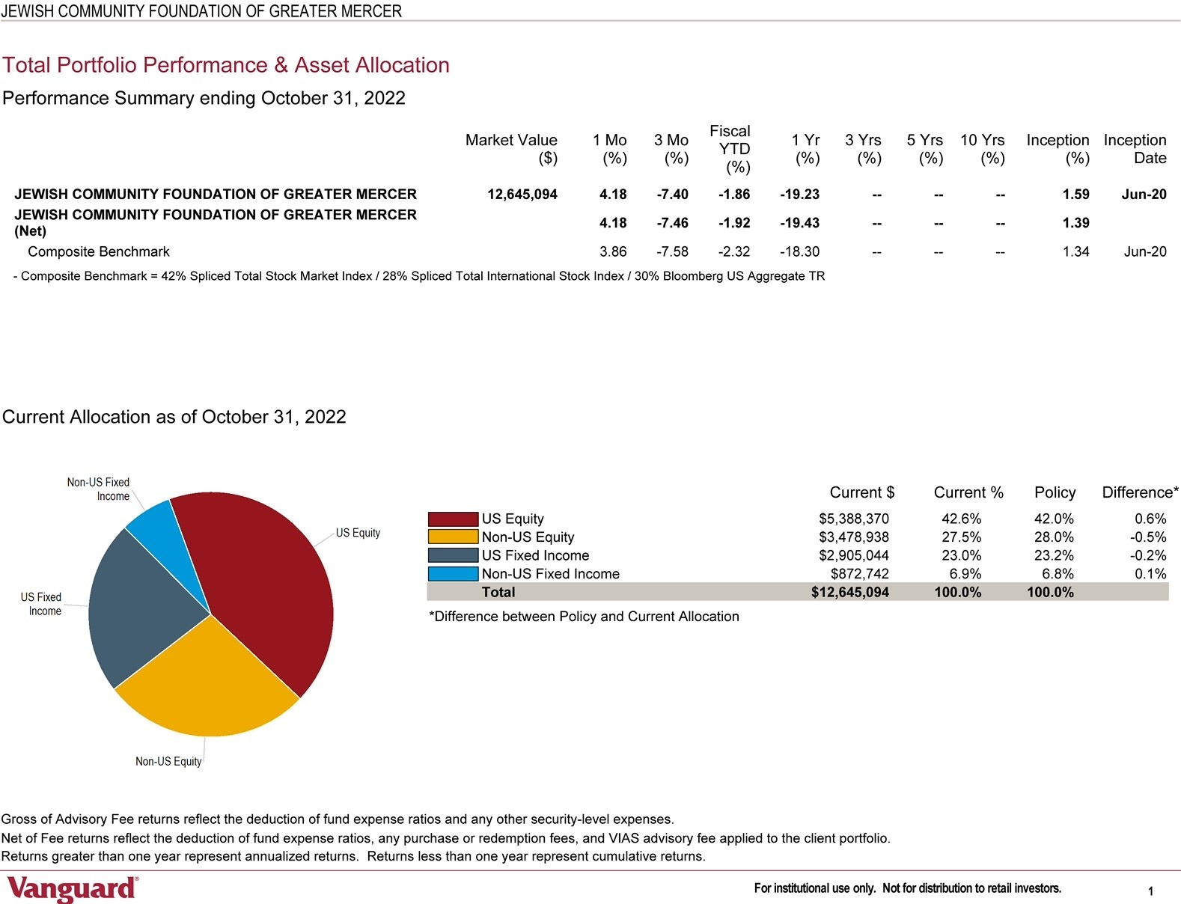
Investment Committee con’t

Slide 12
Committee reports
Marketing Committee
Reviewed marketing plan for FY23
Assisted staff with development of fall newsletter, Foundation talking points for Trustees, and info sheet for professional advisor outreach
Stewardship
Focused on promotion of Oct and Nov community programs, as well as Hanukkah stewardship
Recommended that JCFGM should present to investment committees of partner orgs, and should inform Institutional partners about annual grants from restricted funds and DAFs
LIFE & LEGACY
Provided guidance on development of winter workshop featuring Laurie Herrick on Choose Abundance
Reviewed other new L&L material, including Promise form, Q&A document and Next Steps document featuring recommended legal language to be used when formalizing Promises

Slide 13
Updates
Ewing Property: A For Sale Sign has been posted on the property

Slide 14
Old Business/New Business

Slide 15
Good and Welfare

Slide 16
Happy Hanukkah

