Slide 1
JCFGM Board of Trustees Meeting
SEPTEMBER 19, 2022

Slide 2
JCFGM Mission Statement
The Foundation is organized to promote philanthropy and to further the charitable needs of the Jewish community, other charitable institutions, and community organizations.

Slide 3
Agenda
Call to order
Guest Speaker: Arlene Schiff, National Director of the Life & Legacy program, Harold Grinspoon Foundation
Minutes of the June meeting
President’s report
Annual insurance review
Assets and Fund Activity
Federation grant for Life & Legacy
Strategic Planning Update
Treasurer’s Report
Technology committee report
Committee Reports
Investment committee
Book Awards
Marketing
Upcoming Programs
Upcoming Meetings
Good and Welfare

Slide 4
Funds and Assets
Number of Funds as of 9.9.22
Permanently Restricted 24
Temporarily Restricted 11
Custodial Funds 31 (Four restricted funds have been re-classified as custodial funds.)
Donor Advised Funds 80
Foundation Funds 5
Total 151
New Funds in FY23:
Custodial Funds 1
Donor Advised Funds 5 *
Total 6
* One new DAF is our inaugural Mitzvah Match Fund, co-sponsored by Jewish Federation PMB and in partnership with JFCS , JCYF and the Foundation. It is a giving opportunity presented to graduating seniors from the JCYF program with a lower fund balance requirement ($900 minimum), lower minimum grant threshold ($36), limitations on recommending grants, and a 5-year fee waiver. The Foundation will contribute $180 to this fund and the Federation will contribute $360.
Contributions (7.1.22 through 9.9.22): $103,568
Grants (7.1.22 through 9.9.22): $433,434
Assets (9.19.22) $13,035,091.32

Slide 5
President’s Report
The New Mission Statement
Annual Insurance Review
  Don Leibowitz (former trustee), Linda and Chip met with Jeff Perlman and Brian Anstock from CBIZ (formerly Borden and Perlman) on August 9 to review insurance coverage. The recommendation was made for JCFGM to purchase non-owned auto coverage. The premium is $54 year. This covers exposure arising from people using personal vehicles while on Foundation business.
Federation Grant for Life & Legacy
  Federation PMB held a round of grant allocations. JCFGM was awarded $2,500 to fund community-wide programming to further the Life & Legacy program.
Strategic Planning Next Steps:
  The committee met on August 10th and decided that JCFGM would move ahead on strategic planning with the board and staff taking key roles.
  Committee recommendations:
  Board task forces will be formed, each with a staff member for support and staff representation on key aspects of the strategic plan.
  The committee will be meeting on October 6th to discuss the details of the plan and form the strategic planning task forces. The expectation is each board member will serve on 1 strategic plan task force.
  The committee believes that the process and eventual outcome will be much more useful and meaningful with the input of the entire board through the task force process.
  The timeline for task forces is October 2022 to March 2023 with a full report at a special board meeting in May.

Slide 6
Treasurer’s report

Slide 7
Technology Committee Report

Slide 8
Committee reports
Investment Committee
The Investment Committee met on September 12, 2022
Assets as of August 31, 2022 were $13,342,401
Returns for latest fiscal year to date (Sine June 30) are 2.12%, in line with the 70/30 benchmark return of 2.25%
Last October (2021) JCFGM added Inflation Protected Bonds to our portfolio and that has been an extremely beneficial move, adding 1% to portfolio performance. The committee is reviewing that position

Slide 9
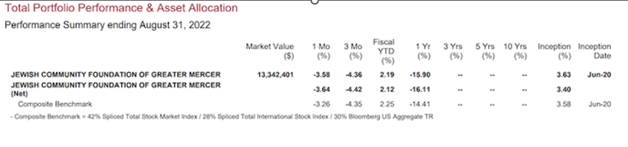
Investment Committee report

Slide 10
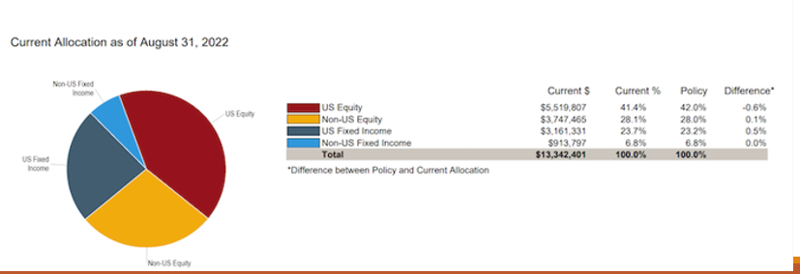
Investment Committee report

Slide 11
Committee reports
Book Awards committee
The Book Awards committee met on August 8, 2022. There were 11 applicants, consisting of 3 new students and 8 returning students.
The Committee awarded four students $1,000 each and seven students $750 each. JCFGM has applied to JCYF for additional funding for the FY23 year.
We’re always refining our student review process and are now able to move through the candidates in an organized, consistent and timely manner to make the awards.
  We're very fortunate to have Kim Marks on our team, who aggregates the key student data into our refined format for analysis.
Because we have limited funds each year, we continually strive to strike a balance for the students to ensure the Book Awards are worth their investment of time with the application process.
This was the first year JFedSHAW was included but there were no applicants. They're on our radar for next year but it may just be a matter of time before they participate.

Slide 12
Committee reports (Cont’d)
Marketing committee
The Marketing committee met Sept. 19
  Reviewed newsletter
Social Media Influencers – need board members, active on each platform to push out our content
  Instagram and Facebook
  LinkedIn
Talking Points for Board members
Professional Advisor one-pager
Continuing to work on Marketing Plan

Slide 13
Life & Legacy
Life & Legacy High Holiday ads are appearing in partner newsletters, emails, and social media; JCFGM also designed a community-wide High Holiday card for all Legacy Promise Makers, fundholders, partners, and friends.
New Promise Form is now available; digital version is in development.
L&L Workshop on Oct 12 at Beth El Synagogue Sukkah – Linda will lead a philanthropy ”card game” to explore the language one uses when having legacy giving conversations.
Expanded L&L Steering Committee, with more community representation, to meet Oct 14.
Winter workshop series featuring Laurie Herrick and ”Choose Abundance” – Dec 5 and Jan 30. Intended for all community stakeholders, partner leadership, and L&L committees. Funded by Jewish Federation PMB.
Amy will be holding fall meetings in Oct/Nov with all partners; agenda to focus on prospect lists, Legacy Shabbat dates, and stewardship opportunities.
Our partners include: Federation PMB, JFCS, Beth El Synagogue, The Jewish Center, Adath Israel, JCC, Beth Chaim, Greenwood House, Greater Trenton Jewish Cemetery Project, CBOI, plus JCFGM

Slide 14
Jewish Community Foundation
2022-2023 Confirmed Programs
Life & Legacy Education
October 12 at 11:30am-1pm - Lunch and Learn in the Beth El Synagogue Sukkah
A Philanthropy Card Game and Conversation with Linda Meisel, Exploring the Language of Giving
Financial & Charitable Planning
October 20 at 7-8pm - The Economy, Markets and Philanthropy: Considerations for Year-End Planning and Implementing Your Charitable Objectives
A panel discussion featuring Marc Shegoski, Managing Director, UBS; Thomas J. Moore, Vice President, Endowment and Foundation Advisory, Glenmede; and Margaret Spaziani, Attorney and Partner, Lindabury, McCormick, Estabrook & Cooper, P.C. This is an online program.
Honoring Jewish Legacy
November 3 at 7-8pm - The Tragic Story of the St. Louis through the Experience of One Family
Featuring Adina Langer, Kennesaw State University Curator, Museum of History and Holocaust Education. This is an online program.
Community Information Program
January 18 at 7-8pm - Impact of Midterm Elections on Local Jewish Communities
Featuring Benjamin Dworkin, Founding Director of the Rowan Institute for Public Policy and Citizenship (RIPPAC), Rowan University. This is an online program.

Slide 15
Committee Meeting Dates
Marketing Committee – Sep 19 at 1pm
Stewardship Committee – Sep 30 at 1pm
Strategic Planning Committee – Oct 6 at 7:30pm
Life & Legacy Committee – Oct 14 at 1pm
Investment Committee – Dec 12 at 7pm

Slide 16
Community Events
October 9 JFCS Meals for Wheels annual bike ride
October 16 JCC Sukkot Event
October 19 Jewish Federation Campaign Kick-off Event
November 5 Beth El Synagogue Fall Fundraiser
December 8 AJC annual dinner honoring Michael and Lori Feldstein
May 21, 2023 Jewish American Heritage Month Festival

Slide 17
Good and Welfare
Mazel Tov to Howard and Janet Cohen on the marriage of daughter Shelley to Matt this past weekend
Mazel Tov to former Trustee Dan Brent and Sally Steinberg-Brent on the birth of new granddaughter, Jodie
Safe travels to Joyce and Jerry Kalstein on their extended trip to France. Bon Voyage!

Slide 18



