Slide 1
Jewish Community Foundation of Greater Mercer
Board of Trustees annual Board Meeting via zoom
Monday, June 23, 2022

Slide 2
JCFGM Mission Statement
The Foundation is organized to promote philanthropy and to further the charitable needs of the Jewish community, other charitable institutions, and community organizations.

Slide 3
JCFGM Board Meeting Agenda
Call to order
Minutes from March Board meeting
President’s Report
Treasurer’s Report
Executive Director’s Annual Report
Nominating committee
Committee reports:
a. Investment committee
b. . Marketing committee
c. Ewing Property
d. Good and Welfare

Slide 4
President’s Report
Report of Fund meetings with Jewish Federation PMB
Strategic Planning meeting on June 27th, 2022 at 7:30 PM
Standing rules
Conflict of interest forms

Slide 5
Assets and Fund Update
Assets as of June
Funds Opened: July 1, 2021 – May 31, 2022
Funds Closed: July 1, 2021- May 31, 2022
Funds:
Endowment and Permanently restricted
Temporarily restricted
Custodial
Donor Advised Funds
Total Funds:

Slide 6
Federation/Foundation Funds
Assets of the Federation
Richard Kohn Endowment Fund
Kravitz PACE Fund
Kobak LOJE Fund
UJFPMB Estates Fund
Assets of the Foundation
Berkowitz Legacy Fund
Koppelman Fund
Applestein Fund
RMK PACE Fund
Klatzkin PACE Fund
UJFPMB Income Fund

Slide 7
Process and Agreement
June 30 statements will be shared with the Federation no later than August 5th.
Income calculations for custodial funds will be calculated on an average 12 quarter lookback basis unless the Federation requests otherwise. All requests will be in writing and signed by the Federation president and treasurer
In no case shall the Foundation change the payout calculation methodology of any fund that is an asset of the Foundation where the Federation is a beneficiary without written agreement from the then President and Treasurer of the Federation
Distributions for all funds in this document are to be equal to the greater of 4% or the amount designated by the Foundation each year, unless the documents establishing a particular fund state otherwise

Slide 8
continued
For all Federation custodial funds, and for restricted funds for which the Federation may request a portion of the corpus, the President and Treasurer shall request the amount for each such fund ,in writing , no later than 21 calendar days after receipt of the 2Q statements.
The Foundation shall use its best efforts to ensure that distributions are to be made to the Federation by September 21, each year.
Federation custodial funds are the property of the Federation. Thus, the Federation and not the foundation is obligated to honor instructions of, and restrictions established by the donor. Foundation is only obligated to comply with Federation distribution requests from custodial funds. It is the responsibility of the Federation to monitor compliance the right of Federation to instruct Foundation as to the amount of any distribution.

Slide 9
Treasurer’s Report

Slide 10
FY 22 Highlights
Life & Legacy:
a. Gail Littman Award to Amy Zacks
b. Each One Reach One – xx new promises to the community and 3 community partners, Beth El Synagogue, Congregation Beth Chaim and The Jewish Center each received $2000 as incentive grants
c. Launching of Life & Legacy Plus with 11 Partners
Community Programs –Please add number of attendees
a. Train Near Madeburg
b. Democrats, Republicans and The Jewish Community
c. The All American Game: Jews and Baseball
d. The Legacy of the Eight Jewish Supreme Court Justices
Life & Legacy Workshops for partners
JFEDSHAW Partnership---xx promises

Slide 11
FY 2022 Highlights
Social media Campaigns
1. Why I made a Legacy promise videos
2. Why I opened a DAF at JCFGM print and video

Slide 12
FY 2022 Highlights
Graphs

Slide 13
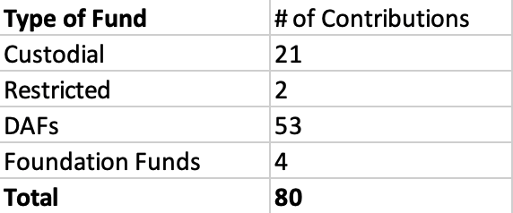
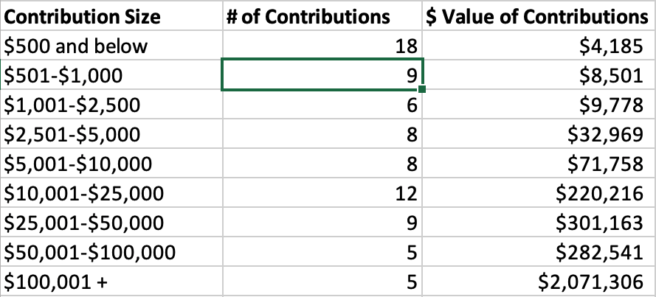
FY22 Highlights
From July 1, 2020 through May 31, 2021, there were 80 contributions to 33 JCFGM funds, totaling $3,002,421.
Update for FYE 2022

Slide 14
Highlights
FY21 Highlights of Funds
4 new DAFs Update for 2022
4 new Custodial Funds
1 new Restricted Fund
1 DAF converted to Restricted Fund
1 DAF converted to Foundation Fund
2 Pending Funds in Process
3 Closed Funds
Number of Funds (as of 5.31.21)
15 Custodial
27 Permanently Restricted
12 Temporarily Restricted
66 Donor Advised Fund
6 Foundation Funds
126 Total Funds

Slide 15
Highlights
From July 1, 2020 through May 31, 2021,
JCFGM processed 451 grants totaling $1,375,290.

Slide 16
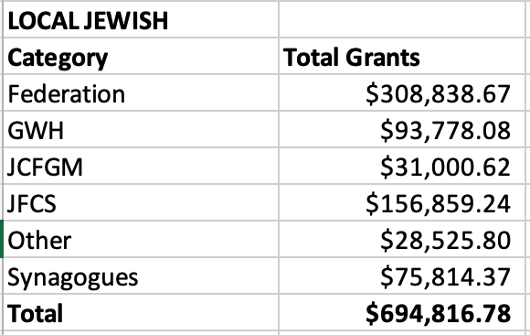
Highlights

Slide 17
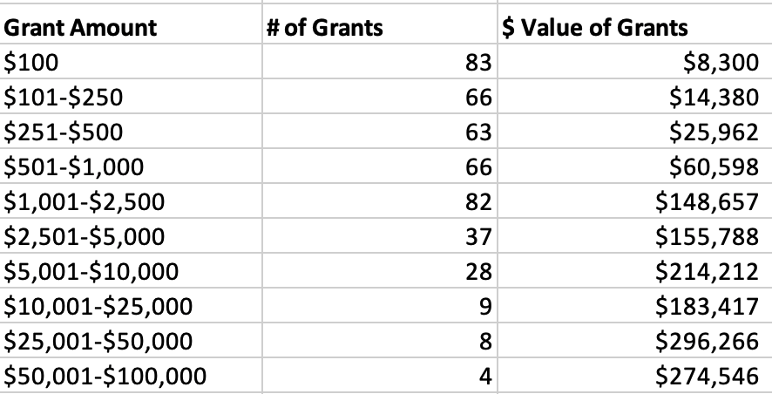
Highlights
Analysis by Grant Amount

Slide 18
Nominating committee Report
Nominating committee report
Nominating committee: Scott Schaefer, Chair
Committee Members: Alex Simanovsky and Tiffany Willner
Outgoing Trustees
Daniel Brent
Donald Leibowitz
Jerry Neumann
Marty Schwartz

Slide 20
Proposed New Board members
Add bio information

Slide 21
Slate

Slide 22
Investment committee
Harvey is sending this on Monday
Investment Committee: Harvey Fram, Chair -- Marty Schwartz, Harvey Fram, Michael Manning, Jerry Neumann, Scott Schaefer , Alex Simanovsky – Michael Saul representing: Jewish Community of Somerset, Hunterdon, Warren

Slide 23
Ewing Property
Howard Cohen, Jim Schragger and Linda Meisel have been meeting monthly with Frasier Pierson, co trustee of the Pierson trust, Kevin Waters, representing Wells Fargo, Logan Pierson, Frasier’s brother and more recently Joe Turulli from Wells Fargo
The Wells Fargo process for marketing the property is layered with approvals and has definitely slowed the more recent movement on marketing the property.
It is now clear however, that Frasier Pierson and Logan Pierson are interested in marketing the property.
We have reached out to Ken Mack who worked on this project in the past for files.
Ewing Property committee: Howard Cohen, Jim Schragger, Scott Schaefer

Slide 24
Marketing committee
The Marketing committee and JCFGM staff team met to review the FYE 2021-22 Marketing initiatives and to plan for FYE 2023.
A formal Marketing plan for FY@# is being developed and the staff team will share this with the board at the September meeting.
Plan highlights will include:
1. Targeted marketing and programs highlighting industry expertise
2. Life & Legacy
Key to a marketing plan is Trustee engagement via social media and Linkedin

Slide 25
Amy – have any other committees met? I don’t think so.– we should probably schedule a stewardship and Legacy committee—do we want to combine them?

Slide 26
Committees
Appointment of Audit Committee
Marc Wistotsky, Chair
Ron Berg
Joshua Waldorf
Appointment of Personnel Committee
Joshua Waldorf, Chair
Stephanie Koren
Miki Krakauer

Slide 27
Future meetings
Strategic Planning meeting: June 27, 2022 at 7:30 via zoom
Executive Committee meeting: August 15, 2022 in person
September Board meeting: September 19, 2022 TBD

Slide 28
Good and Welfare
Mazel tov Marty and Judy Schwartz on the marriage of their grandson Ben
Mazel tov to Marty and Judy Schwartz on the college graduations of their grandchildren Kay and Sam.

