Slide 1
Jewish Community Foundation of Greater Mercer
Executive Committee Meeting
December 19, 2022

Slide 2
Agenda
Call to Order
President’s Report
Assets and Activity
FidTech
Federation – do you want to tell them about Federation and L&L or not?
Executive Director’s Report
Grants to partners via DAFs at year end
Strategic Planning update
Communications Consultant
JCFGM Programs
Board Talking Points

Slide 3
Mission statement
The Foundation is organized to promote philanthropy and to further the charitable needs of the Jewish community, other charitable institutions, and community organizations.

Slide 4
Funds and Assets
Number of Funds as of 12.12.22
Permanently Restricted 24
Temporarily Restricted 11
Custodial Funds 31
Donor Advised Funds 82 (including one pending DAF)
Foundation Funds 5
Total 153
New Funds in FY23:
Custodial Funds 1
Donor Advised Funds 7 *
Total 8
* One new DAF is our inaugural Mitzvah Fund, co-sponsored by Jewish Federation PMB and in partnership with JFCS and JCYF.
Contributions as of 12.12.22 $470,230
Grants as of 12.12.22 $766,680
Assets: LINDA TO ADD

Slide 5
FidTech status

Slide 6
Treasurer’s Report

Slide 7
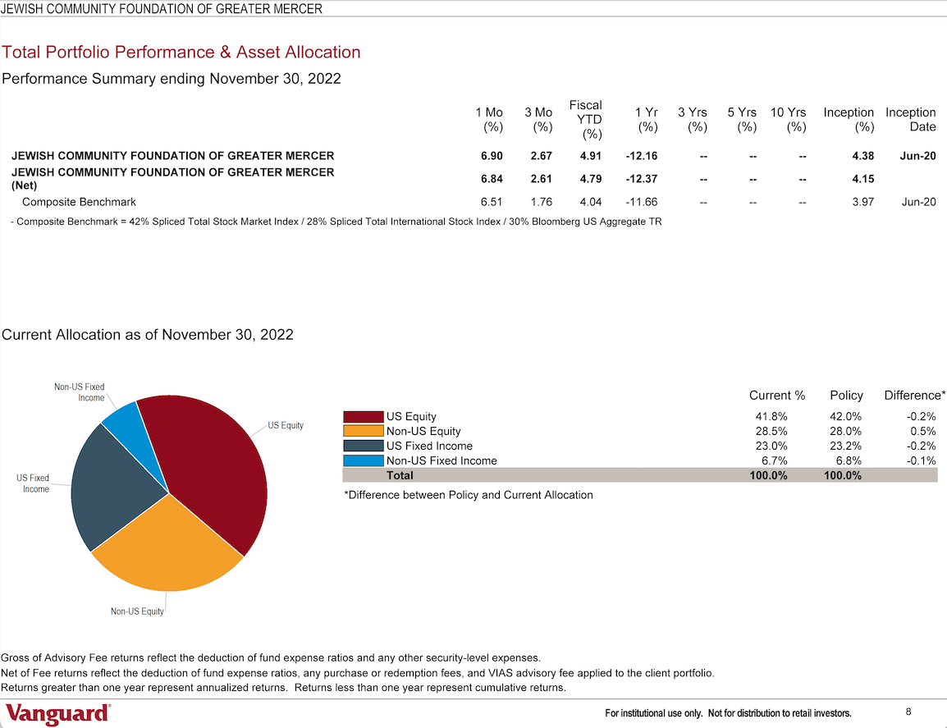
Investment Committee
Report

Slide 8
Strategic Planning status

Slide 9
JCFGM Programs
Culture of Philanthropy – session #2
January 30 at 7:30-8:45pm – Choose Abundance, Life & Legacy Workshop Series
Featuring Laurie Herrick, author, consultant and entrepreneur and featured keynote speaker at LIFE & LEGACY annual conference
Sponsored by Jewish Federation of Princeton Mercer Bucks
Jewish Community Program
January 18 at 7-8pm - Impact of the 2022 Midterm Elections on Local Jewish Communities
Featuring Benjamin Dworkin, Founding Director of the Rowan Institute for Public Policy and Citizenship (RIPPAC), Rowan University.
Co-sponsored by Jewish Community Relations Council of Somerset, Hunterdon & Warren Counties
LIFE & LEGACY Celebration
May 18 at 5-7pm at The Jewish Center courtyard

Slide 10
Good and Welfare

