Slide 1

Jewish Community Foundation of Greater Mercer
Board of Trustees meeting
November 27, 2023

Slide 2
Mission statement
The Foundation is organized to promote philanthropy and to further the charitable needs of the Jewish community, other charitable institutions, and community organizations.

Slide 3
Agenda
Call to order
Minutes of the September 18, 2023 meeting
President’s Report
Assets and Funds report
Update on Conversations with the Jewish Federation PMB and Jewish Federation West Central
This will include the strategic planning committee report
Treasurer’s Report
Executive Director’s Report
Committee Reports
Upcoming Foundation programs
Upcoming Foundation Meetings
Good and Welfare

Slide 4
President’s Report
Assets and Funds report
Update on conversations with Jewish Federation PMB and Jewish Federation West Central.

Slide 5
Funds and Assets
FYE24 July 1, 2023-November 20, 2023
Number of Funds
Foundation Funds 5
Custodial Funds 33- including new NA’AMAT USA Fund $500K
Permanently Restricted 22
Temporarily Restricted 11
Donor Advised Funds 82
Total: 153
Closed Funds 0
Contributions: 45 transactions $1,289.223
Grants: 270 transactions $831,207
Assets: ( as of November 27, 2023) $15,386,299.92

Slide 6
Treasurer’s report

Slide 7
Executive Director’s report
Congressional Legislation regarding Donor Advised Funds
Social Media Update! Recent posts include (see designs on the following slides):
National Philanthropy Day, honoring Richard Glazer z”l
DAF grants in support of Israel aid
Investing in a Jewish Community
Giving through an IRA Required Minimum Distribution (RMD)
New Institutional Partner: NA’AMAT USA
New idea for 2024: Board Member Blog

Slide 8


Slide 9
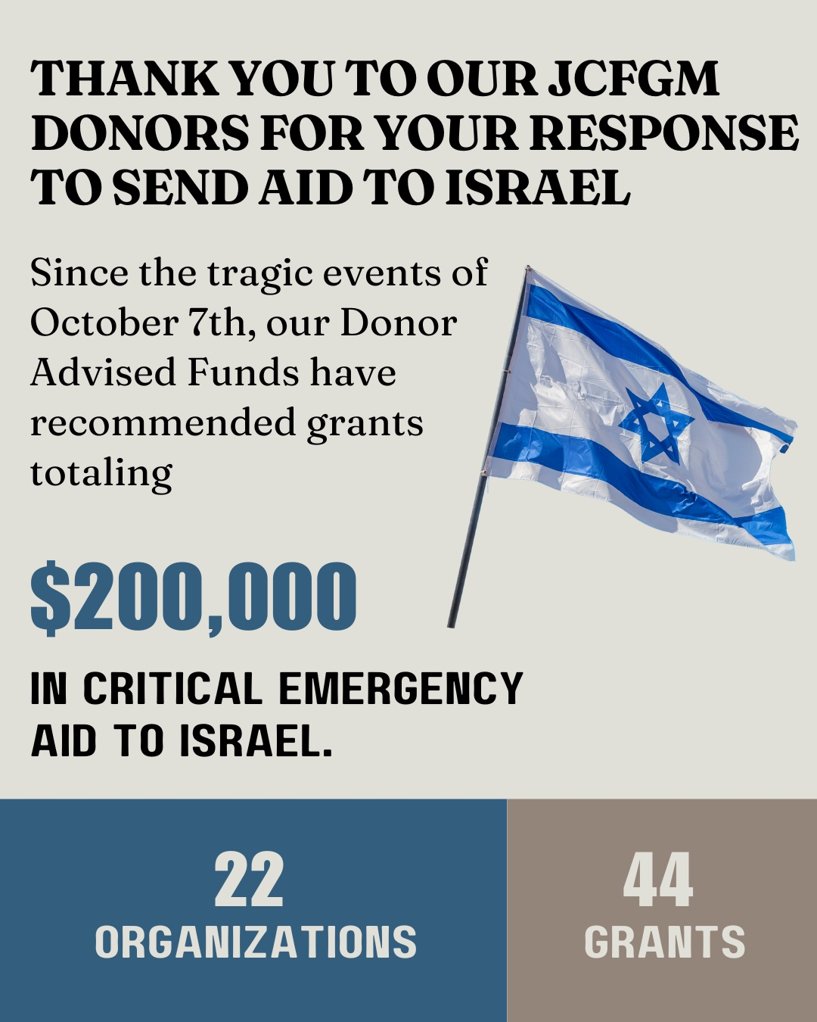

Slide 10
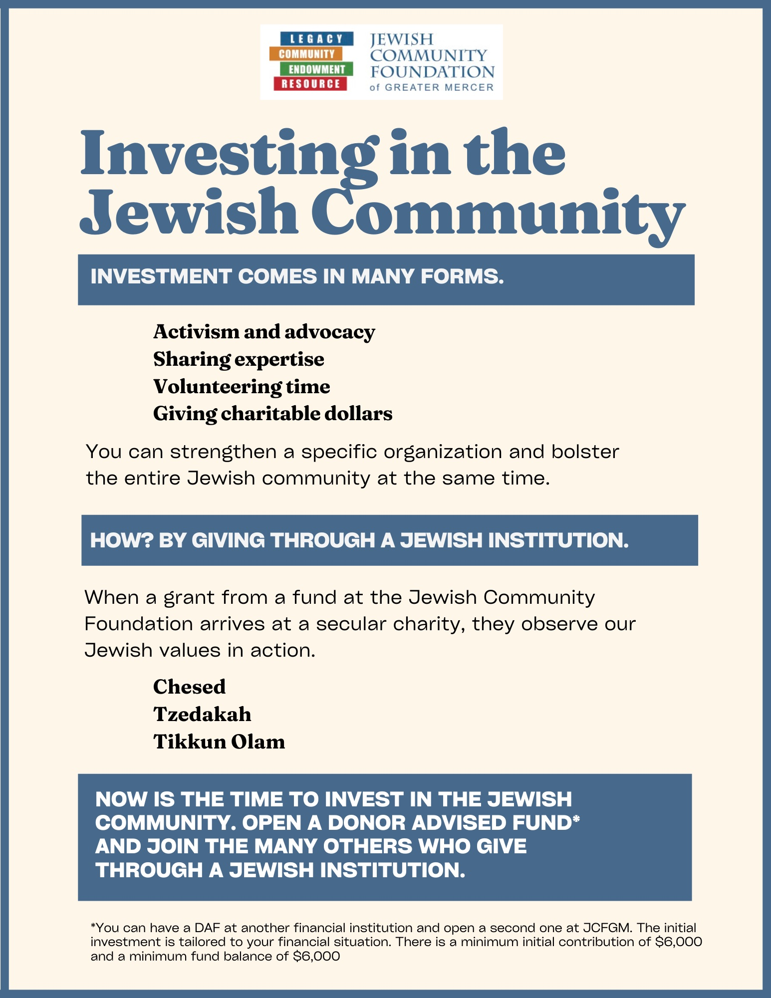

Slide 11
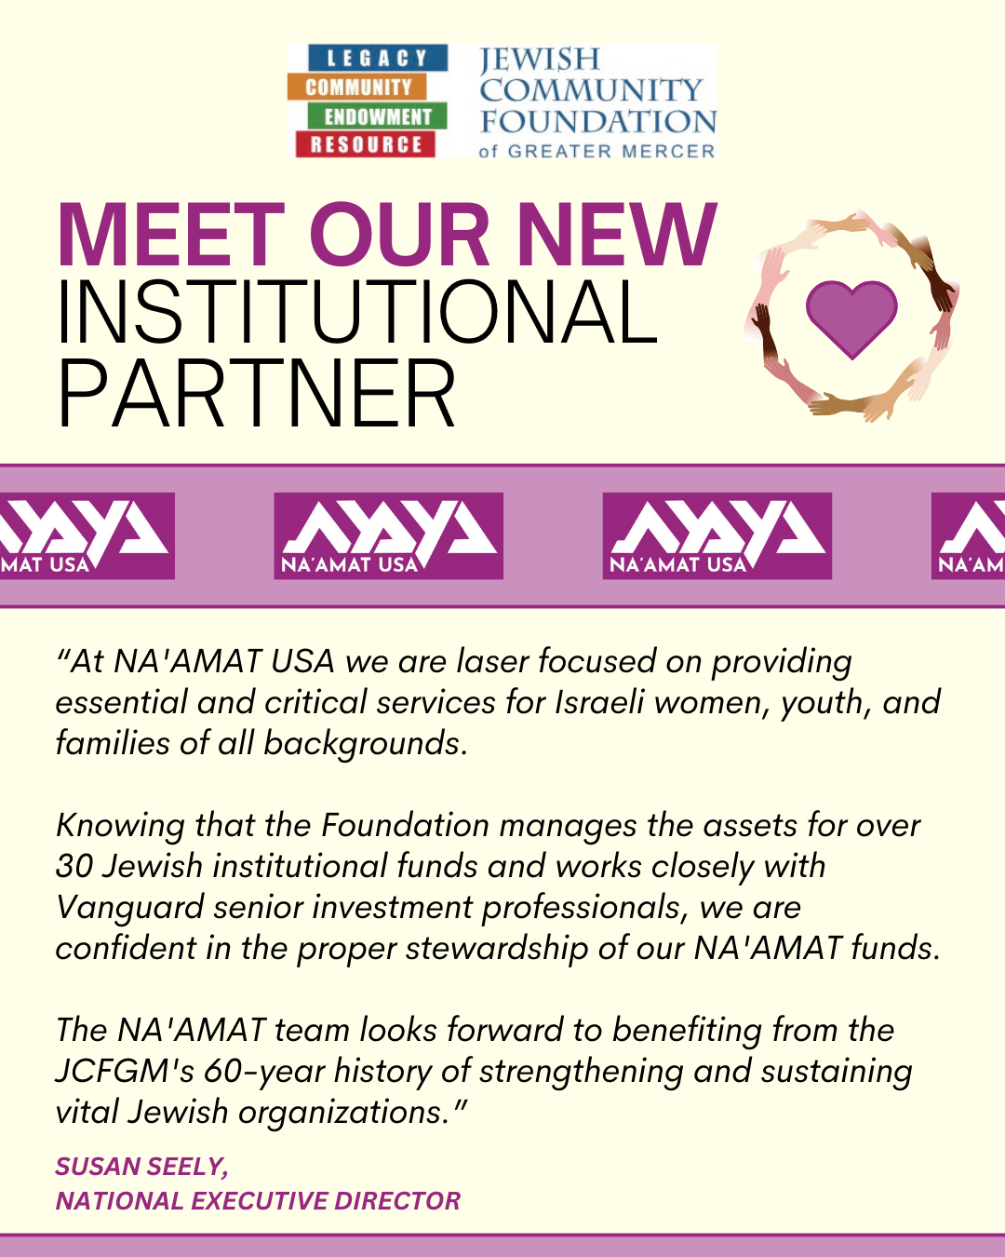

Slide 12

Life & Legacy
Federation PMB Funding $10,000 to fund training and workshops
Fall Partner Meetings – We are meeting quarterly with each team and collectively with the West Central organizations.
December 6, 2023
Zoom Workshop featuring Powerhouse Communities
Legacy Shabbats
Kehilat Hanahar – Dec 14 (Hanukkah)
Beth El Synagogue – Jan 6
Adath Israel – Feb 2
Beth Chaim – Feb 16
The Jewish Center – Mar 9
Board members who are members of these organizations are asked to join us at these events.
Tu Bishvat – Digital listing of all L&L donors community wide on Jan 24
L&L Celebration will be combined with the 60th Anniversary gathering on May 23 and will feature a digital Book of Life – more details to come!

Slide 13
Investment committee
For the calendar year to date (to the end of October) the portfolio has returned 4.18% compared to 3.37% for the benchmark (calculated by Vanguard) September return-2.50%,ahead of the benchmark thanks to the actively managed international allocation.
For the 3 yrs. 4 months JCFGM has used Vanguard as the fund manager, returns of 3.31% net of all Vanguard and mutual fund fees are ahead of the benchmark (3.03% annualized)
During September, the investment committee voted to make a major change to the fixed income portfolio to take advantage of a recent anomaly in bond yields where each of long-term government bonds has a higher yield than the benchmark. As a result, the fixed income portfolio is now made up of the Vanguard Federal Money Market Fund (60%) and the Vanguard Long-term Treasury Index Fund (40%)where that ration has the same duration risk (interest rate sensitivity) as the benchmark
We are looking into offering Conservative and Aggressive Portfolio Allocation options, in addition to our current Moderate Portfolio Allocation option.

Slide 14
Insurance review report
Annual Insurance review meeting was on August 17, 2023. Board Trustees Jim Schragger and Marc Wisotsky, represented the board, Linda Miesel was present as staff. CBIZ was represented by Jeff Perlman and Brian Anstock
Brian presented the current packet of insurance coverage which includes
Officers and Directors insurance
General Liability Coverage
Cyber and Crime Coverage
Both Jeff and Brian advised that the current coverage is appropriate for an organization the size of the Foundation
A copy of the insurance packet is available for view by Board members on the Board portal under institutional documents.

Slide 15
Committee reports
Ewing Property update: We were scheduled to meet on November 30, 2023 at 12 noon via zoom.
Audit Committee: The audit Field work is scheduled to be completed by December 31, 2023.

Slide 16
Upcoming Foundation programs
December 3, 2023, 10:30-11:30am
Four Mothers
Featuring Dr. Leonard Rutgers, American trained Dutch archaeologist who will offer new insights into the history and ancestry of Ashkenazi Jews. Co-sponsored by the Jewish Federation of West-Central New Jersey.
February 12, 2024, 7-8pm
What should be Top of Mind for the Jewish Community in the 2024 Election Season?
Featuring Dr. Benjamin Dworkin, Founding Director of the Rowan Institute for Public Policy, and Citizenship (RIPPAC) at Rowan University. Co-sponsored by the Jewish Federations of Princeton Mercer Bucks and West-Central New Jersey.
March 4, 2024, 7-8pm
Jewish Life on College Campuses
Panel featuring student representatives, Rabbi Gil Steinlauf, Center for Jewish Life at Princeton University, and Rabbi Esther Reed, Hillel at Rutgers University. Co-sponsored by the Jewish Federation of Princeton Mercer Bucks.
May 23, 2024, 5-7pm – NEW DATE!
Jewish Community Foundation of Greater Mercer 60th Anniversary Celebration
In-Person Cocktail Reception

Slide 17
Upcoming EC and Board meetings
January 29, 2024 Board of Trustees meeting 7:30 PM
February 26,2024 Executive Committee meeting 7:30 PM
March 25, 2024 Board of Trustees Meeting 7:30 PM
April 15, Executive Committee meeting 7:30 PM
May 20, 2024 Board of Trustees meeting- FYE 2025 Budget Presentation 7:30 PM
June 10, 2024 Annual Meeting 7:30 PM
SAVE THE DATE: Jewish Community Foundation of Greater Mercer 60th Anniversary and Life & Legacy Celebration 5 PM – 7PM

Slide 18
Good and Welfare
Mazel Tov to Jeff and Lois Miller IHO the engagement of their daughter Haley to Martin

Slide 19

Happy Hanukkah

