Slide 1

Jewish Community Foundation of Greater Mercer
Annual Board of Trustees meeting
June 10, 2024

Slide 2
Mission statement
The Foundation is organized to promote philanthropy and to further the charitable needs of the Jewish community, other charitable institutions, and community organizations.

Slide 3
Agenda
Call to order
Approval of Minutes 3.25.24
President’s Report
Board confidentiality
Treasurer’s report
YTD Budget
Proposed FYE 25 Budget
Executive Director’s Report
Committee Reports
Updates

Slide 4
Assets and Funds report
FY24 to date (July 1, 2023 - May 31,2024)
Number of Funds
Foundation Funds 5
Custodial Funds 36
Restricted 33
Donor Advised Funds 83 (Note: a new Mitzvah Fund is in the processing of opening)
Total: 157
Closed Funds: 4
Contributions
118 contributions to Funds
Totaling $2,785,976
Grants:
642 Grants
$1,648,305
$17,619,168.57 : (6.10.24)

Slide 5
President’s report
Board confidentiality

Slide 6
Treasurer’s Report

Slide 7
Executive Director’s report
The Executive Director’s report was emailed to members of the Board.

Slide 8
Committee reports
Investment committee
The investment committee had explored offering multiple investment options. FidTech the back office provider charges $500 per month for this feature. We are going to try to ascertain what percentage of fund holders would be interested before pursing further.
The next Investment committee meeting is Monday, June 17th. The committee will meet with Dan Voss, Mercer. At this point there have been no changes in the fees or systems since the acquisition of Vanguard by Mercer.
Investment committee: Harvey Fram, chair, Michael Manning, Marty Schwartz, Geoff Feinstein, Michael Saul, Alex Simanovsky, Jerry Neumann ex officio Chip Loeb and Joyce Kalstein

Slide 9
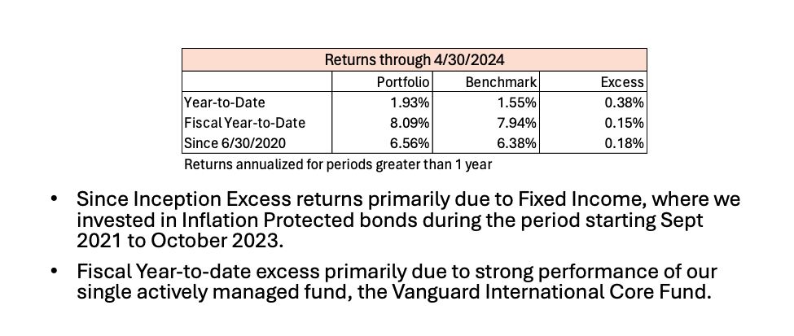
Investment Committee con’t.

Slide 10
Succession/Search committee
The members of the Succession/Search committee are: Joyce Kalstein, Stephanie Koren, Jill Schwartz Chevlin and Josh Waldorf
The Succession committee has met 6 times via zoom since the last board meeting.
The job was posted in Indeed, Jewish Staffing.com, Women in Development(NJ) Jewish Federation of North America job site, Harold Grinspoon Foundation job site, Hillel job site, Linkedin
We received over 100 resumes
The committee narrowed the pool to 6 potential candidates based on the following attributes:
Education
Fundraising/Development Professional
Location
Work Experience
Experience working with a Volunteer Board/Committee

Slide 11
Succession/Search
The committee developed first round questions to conduct six interviews over three days last week.
The committee rated each candidate on a scale of 1-5 on the following
Leadership skills
Supervision/Management experience
Fundraising Experience
Knowledge of Planned Giving Stewardship and Life & Legacy giving
The committee is meeting on 6/14 to narrow the field and set up the next round of interviews which will be conducted by the succession committee members and a to be determined number of Trustees
Succession/Search committee: Joyce Kalstein, Stephanie Koren, Jill Schwartz-Chevlin, Josh Waldorf

Slide 12
Nominating committee
The Nominating committee met several times in the months of April and May.
Wally Yosefat and Brenda Zlatin will be leaving both the board and the Executive Committee
Additionally, Steve Lieberman (West Central) and Oliver Pimley will be leaving the board. Jonathan Nemeth has filled the seat vacated by Steve Lieberman.
Tiffany Willner will remain on the Executive Committee as board member at Large
Two Trustees will be moving to the Executive Committee: James Schragger to Secretary and Susan Falcon as Board member at Large
Norma Saks will join the Board.
Jewish Federation of West-Central will notify JCFGM of their board representative

Slide 13
Nominating committee
Vote on all members of the Executive Committee for a 1 year term
Vote on Norma Saks for a 1 year term on the Board of Trustees
Vote for Michael Feldstein for a 2 year term on the Board of Trustees
Vote on the following individuals for a 3 year term on the Board of Trustees: Harvey Fram,
Joyce Kalstein, Miki Krakauer, Michael Manning, Tiffany Willner
Nominating committee: Scott Schaefer, Chair, Tiffany Willner and Marc Wisotsky

Slide 14
Audit committee
The following Board members have agreed to serve on the audit committee
Chair, Marc Wisotsky
Committee members
Josh Waldorf
Miki Kraukauer

Slide 15
Updates
Ewing Property
Current committee ( Jim Schragger, Howard Cohen and Linda Meisel) meeting approximately every 8-10 weeks with Co trustee Fraser Pierson and family member Logan Pierson
The Pierson Estate is attempting to hire an environmental consultant to determine wetlands. If significant wetlands are found, additional consulting services may be needed to update wetlands maps.
Once wetlands are determined/changed, the value of property can be determined
The previous commercial broker’s listing agreement expired
New commercial broker is expected to be engaged once the value of the property is determined
Estate is in the process of terminating Wells Fargo as a co-trustee and may seek a new co-trustee. This is causing delays.
The Foundation has not paid expenses to-date. Upon the sale of the property, all expenses will be taken out of any proceeds from the sale of the property before the net proceeds are divided between the beneficial owners.

Slide 16
JCFGM Fall 2024 Community Programs
September 29th Princeton University Sculpture Tour: led by Sandy Kurinsky ( for board members, fund holders and Legacy team members.)
October 15 Legacy Letters Stewardship Program: zoom program
October 21 Farewell to Linda and Welcome New ED in person
October 28th Savvy Strategies for Year End Charitable Giving featuring Chartered Philanthropy Advisor Professionals – zoom
November 13 The Experience of Jewish GIs featuring Deborah Dash Moore- zoom program

Slide 17
Good and Welfare
Condolences to the Zacks family on the passing of Amy’s Dad, Michael Falk. May his memory be for a blessing.
Mazal tov to:
  The Snow Nagelberg Family in honor of Ari’s graduation from the University of Pennsylvania
  The Feldstein Family in honor of Carly’s graduation from Emory University
  The Willner Family in honor of Natalie’s graduation from Princeton Day School
  The Meisel family in honor of granddaughter Ava’s graduation from Fieldston Upper School

